Slide 1
Efficient Prediction of Annual Yield from Stocks Using Hybrid Deep Learning (ID:135)
Ashish Papanai
Maharaja Agrasen Institute of Technology
Notes:
Hello Everyone,
I am Ashish Papanai and I am here to present the paper titled, “Efficient Prediction of Annual Yield from Stocks Using Hybrid Deep Learning”.

Slide 2
Background
Literature Survey
Problem Description
Methodology
Results and Discussion
Conclusion
Notes:
We will start by discussing the background of the study, followed by the literature reviewed,
the problem we try to solve using the proposed solution,
the methods used to generate the results,
the results generated from our approach,
and finally the conclusion drawn from the study.

Slide 3
Various financial and non-financial factors govern the outcome of investing in a particular company or business.
The financial factors include: Performance of the business (historical data), cash-flow, dividend, discount rate, risk rate, et cetera
The non-financial factors governing stock prices are: ESG (Environment, Social, Governance)
This study analyzes financial factors, explicitly dealing with Historical Stock Data to predict the annual yield.
Notes:
As we all know, Predicting the yield from stock is essential for current and future investors.
It decides how much they will make or lose by making that investment.
There are various financial and non-financial factors affecting market volatility.
This study's scope is limited to a financial factor, Which is the historical time-series data.

Slide 4
There are various statistical and mathematical models available in the public domain
Statistical Models:
AR (Auto Regression)
MA (Moving Average)
ARMA (Auto Regression Moving Average)
ARIMA (Auto Regression Integration Moving Average)
Notes:
The statistical models currently used by businesses are:
AR: Future values based on past values.
MA: Smooths out price data by creating a constantly updated average price.
ARMA: Description of a process in terms of two polynomials. One for the autoregression and the second for the moving average.
ARIMA: An autoregressive integrated moving average model generalizes an autoregressive moving average model.

Slide 5
The mathematical models for stock price predictions are computationally expensive and require working knowledge of mathematical and statistical concepts to make accurate predictions.
Mathematical Models:
Black Scholes Model (for options pricing)
Monte Carlo Simulations (Heuristic Approach)
Notes:
Also, there are some differential equations-based Mathematical models, like Black Scholes Model. And heuristic simulations methods like Monte Carlo Simulations.
The drawbacks of the mathematical methods is that they require mathematical and statistical knowledge for improved results.
Although the heuristic models are black-box and require less prior knowledge, they are time-consuming and computationally expensive for large data.

Slide 6
Apart from the Mathematical and Statistical various black-box deep learning models are developed. These models were reviewed and studied as a part of this study.
Deep Learning Models for time series prediction:
RNNs [Vanishing Gradients problem]
LSTMs [Computationally Expensive]
Hybrid-Ensembled Models [Complex to implement]
Notes:
Apart from the heuristic black-box models, advancements in deep-learning architectures and the advent of an extensive amount of data.
Several Deep Learning Models like RNN, LSTMs, and other ensembled models are developed to make historical stock price prediction easier and more accurate.

Slide 7
Model | Architecture | Computation Requirements (Experimental) | Month, Year
FinRL-Podracer (Li et al.) | Reinforcement Learning | 256 CPU cores of Dual AMD Rome 7742 running at 2.25GHz. 8 A100 GPUs and 320 GB GPU memory | November, 2021
FinRL (Xiong et al.) | Reinforcement Learning | 2 Nvidia Titan GPUs | November, 2020
Lu et al. | CNN-LSTM Architecture | Intel i7-4700H 2.6 GHz, 12 GBs of RAM, 500 GB | October, 2020
Notes:
We reviewed the latest model architecture with breakthrough deep learning advancements for the financial market.
1.FinRL-Prodracer: a successor to FinRL, a reinforcement learning market simulation library,
requires 256 CPU Cores and 320 GB GPU,
which is way too expensive for developing a web app and making it available for common people.
2.FinRL: This library simulates the financial market using RL techniques,
but it has a high response time and is computationally expensive compared to the proposed model.
Various CNN-LSTM hybrid architecture was reviewed as a part of this study, such as CNN-LSTM by Lu et al. and Bao et al.

Slide 8
Model | Architecture | Computation Requirements (Experimental) | Month, Year
Bao et al. | Multi-Agent Reinforcement Learning | Multiple NVIDIA Titan X GPUs | June, 2019
StockDL (Our Model) | Hybrid CNN-LSTM ensembled with statistical MA model | Single NVIDIA Titan GPU for results in 120 seconds. Intel i5 10th Generation with 2GB NVIDIA Mx250, results in 180 seconds. | February, 2021 (v0.01 [Beta]) Public presentation March, 2022 (v1.0)
Notes:
The issue with these models was the computational cost and response time.
In this study, I introduce stockDL to you, A Hybrid CNN-LSTM based model.
It takes 120 seconds to predict the annual yield using a single NVIDIA Titan GPU.
And 180-200 seconds to generate annual yield on using 10th Generation Intel i5 CPU (without any dedicated GPU)

Slide 9
Stock price predictions and analysis are an area of primary interest for investors, researchers, and market experts.
The existing mathematical and statistical models (AR, MA, ARMA, ARIMA) require basic to advanced mathematical and statistical concepts to generate optimal results.
A solution to this problem is to use Black-Box (Deep Learning) Models for time series analysis of the historical stock data (LSTM/RNN based models).
Another solution for new investors is to use intuitive and confidence-based methods (Buy and Hold Method).
Notes:
The problem with existing mathematical and statical models, as discussed before, is that the user should have essential to advanced knowledge of mathematical and statistical concepts.
A possible solution is to use a black-box model pre-tuned to generate results with increased accuracy when the data is fed. The drawback with this Black box approach is the computational requirements and the response time, which affects the user experience.
There are intuitive and confidence approaches like Buy and Hold method, in which the user buys when prices are low and holds on to them until the prices increase.

Slide 10
The intuitive methods are risky and can lead to financial losses if the decision taken by the investor is not backed by the account books of the company invested in.
Problem with existing deep learning architectures (LSTM/RNN):
The existing deep learning architectures are computationally expensive and require high-performance GPU clusters for optimal results.
The other drawback of this model architecture is the execution time taken by the model to provide the results and predictions.
Notes:
These intuitive methods are uncertain and, in the best case, might lead to high profits and, in the worst, would lead to bankruptcy.
And the drawbacks of non-optimized deep learning architecture were discussed in the previous slide.

Slide 11
Our Contributions:
An efficient, user-friendly python library (stockDL) for the users for stock price prediction.
The model is dynamically trained and produces the results in less than 120 seconds using NVIDIA Tesla K80 GPU (available on Google Colab) and 180 seconds on using intel i5 10th Generation (Hexacore, 2.90GHz CPU).
We used existing and dynamically updated stock data provided by Yahoo Finance.
The dynamic training strategy employed in the model pipeline makes the predictions immune from any past shocks (more than six years before) to the stock prices.
Notes:
Through this study, we present to the community a use friendly python library, a command line application and a REST API for future stock prediction web-apps.
We have reduced the response time to 120 seconds and reduced the GPU requirement from 2 NVIDIA Titan GPUs to a single NIVIDIA TITAN GPU.
The response time on a hexacore 10th generation intel i5 10th generation CPU is 180 seconds.
This response time is reduced to a few seconds when we use pre-trained model.
We’ve refrained from generating a new dataset, and used data from Yahoo Finance API. The dynamic training strategy employed in the model makes the model predictions immune from any past shocks (like market crash, pandemic, or wars).

Slide 12
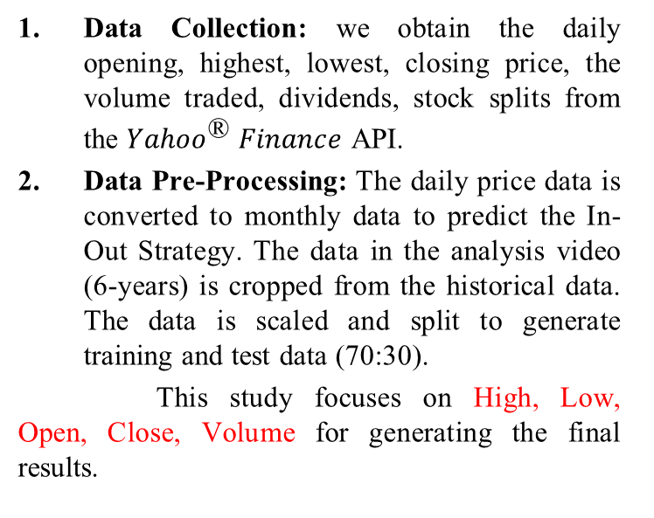
Data Collection (yahoo-finance api)
Data Pre-Processing
Dynamic Model Training
Calculations based on devised strategy.
Generating Results and Plots
Data Collection: we obtain the daily opening, highest, lowest, closing price, the volume traded, dividends, stock splits from the ${Yahoo}^{\text{®️}} Finance$ API.
Data Pre-Processing: The daily price data is converted to monthly data to predict the In-Out Strategy. The data in the analysis video (6-years) is cropped from the historical data. The data is scaled and split to generate training and test data (70:30).
This study focuses on High, Low, Open, Close, Volume for generating the final results.
Model
Pipeline
Notes:
We followed a four-step pipeline to collect data and generate results:
We start by collecting the historical stock data from Yahoo Finance API.
The data is collected for a window of 6 years before the current date, the date of making the prediction.
After generating this six-year window, we convert the data to monthly opening prizes, which will decide if we’ll trade-in or stay out.
This data is finally scaled using Min-Max Scaler.
The scaled data is split in the ratio of 7:3 for creating the training and testing data.

Slide 13
Data Collection (yahoo-finance api)
Data Pre-Processing
Dynamic Model Training
Calculations based on devised strategy.
Generating Results and Plots
Dynamic Model Training: The pre-processed data is fed to the model, which is dynamically trained. And the trained model is cached, providing the user with a choice to use a freshly trained model or a saved model. Dynamic Training reduces errors due to outliers in the historical data. And using the saved models reduces the computational time significantly.
Calculations: The annual yield from stock is calculated based on the in-out strategy devised by the model, and the net yield is calculated by expected and approximate deduction (like taxes, commissions, et cetera)
Model
Pipeline
Notes:
The training data is finally fed to the model architecture, trained when the user makes predictions.
This reduces the chance of error due to unforeseen past events in the stock price data.
We cache the trained models to reduce the prediction time if the user wants to use the saved models.
The output from the model is in the form of 0 and 1. 0 signifies that we’ll stay out in that month, whereas 1 signifies that we’ll trade-in on that month.
Based on this strategy, the calculation module predicts the annual yield and the net yield after any potential deductions; thus, it provides the investor with a strategy to trade and his expected earnings from the trade.

Slide 14
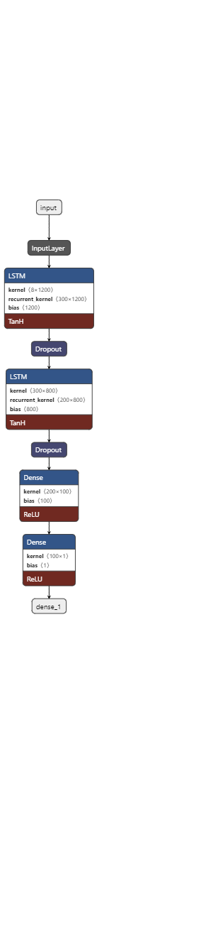
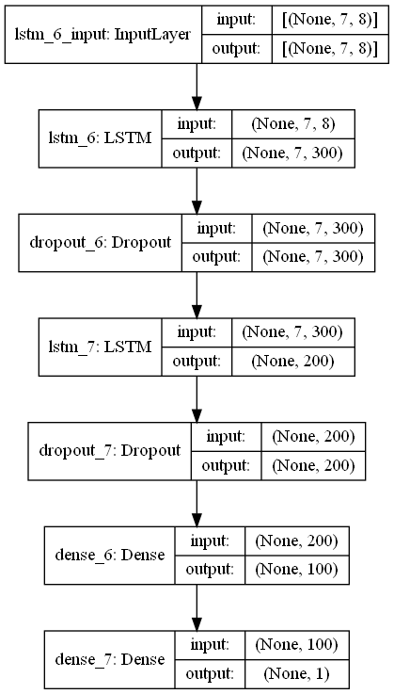
Model Architecture (Vanilla LSTM):
The model comprises A LSTM layer with 300 nodes, followed by a 50% dropout layer to reduce overfitting, Followed by another combination of LSTM (200 nodes) and dropout layer (50%).
The final layers are two dense layers that return 1 or 0, representing in and out, respectively.
Notes:
This study compares the traditional Vanilla Architecture with an improved LSTM-CNN Hybrid or Ensembled model.
The LSTM model comprises two LSTM layers, with the first layer having 300 Nodes. The second LSTM layer has 200 Nodes. Each LSTM layer is followed by a dropout layer which drops 50% of neurons after each LSTM layer.
This helps in preventing overfitting. The final layer of the network is a dense layer that returns 0 or 1, (0 represents staying out of the market for the month, one represents staying in the market for the month to maximize the annual yield).

Slide 15
Training Parameters:
The model is trained for 400 epochs, with 48 batch sizes.
We have used Adam optimizer with an adaptative learning rate to reduce the chances of getting stuck into local minima.
The loss function used and monitored while training is MSE (Mean Square Error)
Notes:
The model is trained for 400 epochs with 48 batches at a time. We used adam optimizer with an adaptative learning rate. This prevents us from getting stuck in local minima.
We tested various regression-specific loss functions for the model, and finally, we used Mean Squared Error to evaluate the loss and reduce it eventually while training the model.

Slide 16

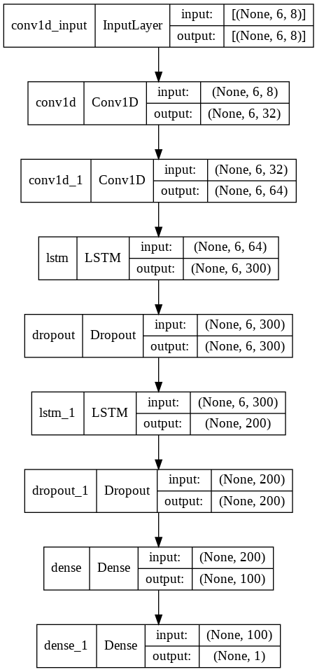
Model Architecture (Hybrid LSTM-CNN):
The first layer of the model is a 1-dimensional CNN layer, with 32 filters and a kernel size of two. This is followed by another 1-dimensional CNN layer with 64 filters, kernel size as 2 and both layers with ‘ReLU’ activation function.
Notes:
While optimizing the vanilla LSTM architecture, we tried adding more LSTM layers and increasing the number of nodes in the existing architecture. This increased the model's response time and computational requirement for faster predictions.
To overcome the speed and efficiency trade-off, we developed a CNN-LSTM ensembled model. The first layer of the model is a 1D convolution layer with 32 filters and two kernels. This is followed by another 1D convolution layer with 64 filters and two kernels. We have used Rectified linear unit as the activation function for both CNN layers. As CNNs are well known for feature extraction, these layers work at much less cost than LSTMs and initially fulfill the requirements of extracting the feature.

Slide 17
Model Architecture (Hybrid LSTM-CNN):
The third layer is an LSTM Layer with 300 nodes, followed by a 50% dropout layers to reduce overfitting, Followed by another combination of LSTM (200 nodes) and dropout layer (50%).
The final layers are two dense layer that return 1 or 0, representing in and out, respectively.
Notes:
The layers following CNN are two LSTM Layers with 300 and 200 nodes, respectively. Each LSTM layer is followed by a dropout layer which drops out 50% of neurons to reduce overfitting.
And finally, the dense layer returns 0 and 1, representing our predicted training strategy.

Slide 18
Training Parameters: [Similar as Vanilla LSTM Model]
The model is trained for 400 epochs, with 48 batch size.
We have used Adam optimizer with adaptative learning rate to reduce the chances of getting stuck into local minima.
The loss function used and monitored while training is MSE (Mean Square Error)
Notes:
The training strategy used for the ensembled model is the same as the vanilla LSTM model, but this can be stopped earlier, around 200 epochs, as we don’t get much decrement in model loss after 200 epochs.
We trained the model with 400 epochs with 48 batches at a time. The optimizer used was ADAM and Mean Squared Error as the Loss Function.

Slide 19
Advantage of (Hybrid LSTM-CNN):
The hybrid LSTM-CNN architecture reduces the computational cost, as instead of using LSTM for feature extraction, we have employed CNN Layer.
This further enhances the quality of predictions as LSTM layers get much cleaner, extracted data for further analysis.
Notes:
The advantage of using the LSTM-CNN model has improved efficiency without much response time.
And
Better quality of predictions as CNN extracts essential features, and LSTM gets to analyze the time-series data.

Slide 20
Predictions made on stocks of RELIANCE (Reliance Industries Ltd), HDFCBANK.NS (HDFC Bank Limited), AAPL (Apple Inc.), GOOGL (Alphabet Inc.)
Method | Predicted Net Yield (GOOGLE) | Predicted Net Yield (HDFC) | Predicted Net Yield (APPLE) | Predicted Net Yield (RELIANCE)
Buy and Hold | 23.25 | 20.25 | 20.25 | 28.42
Moving Average | 10.9 | 10.9 | 20.9 | 21.14
LSTM | 19.97 | 19.97 | 19.97 | 19.17
Hybrid CNN-LSTM | 20.69 | 19.99 | 19.99 | 19.31
Notes:
The predictions made by the models are available as pandas data frame and in JavaScript Object Notation, for better utilisation in web apps.
This table shows the predicted annual yield by using the analysed prediction strategies.

Slide 21
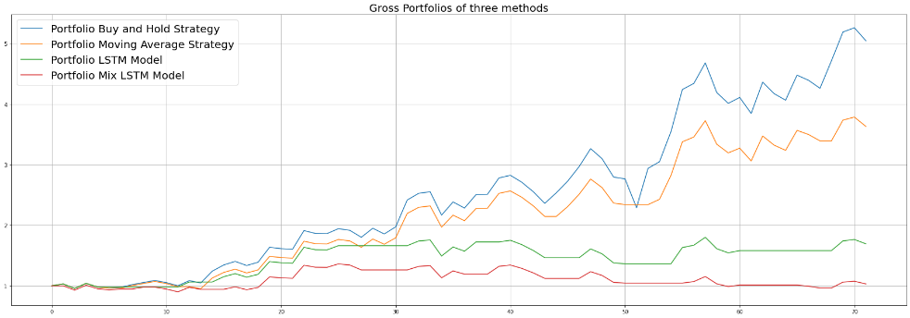
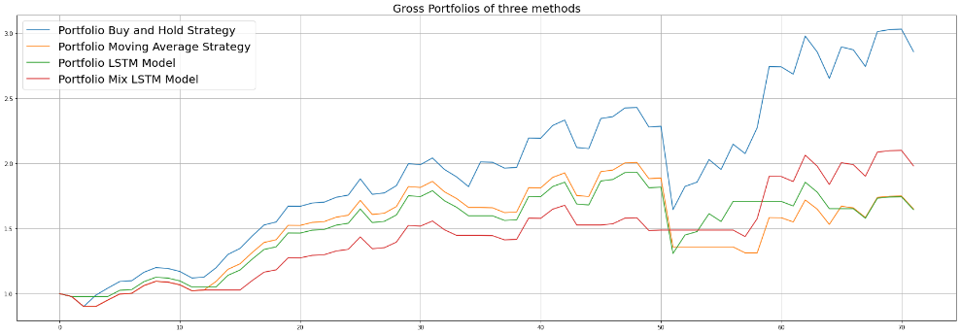
Prediction Plots:
(Indian Stocks, National Stock Exchange (NSE))
Reliance Industries Ltd. (RELIANCE)
HDFC Bank (HDFCBANK)
Notes:
These plots were generated from stockDL, representing the predicted growth curve of Reliance and HDFC for the considered financial year.

Slide 22
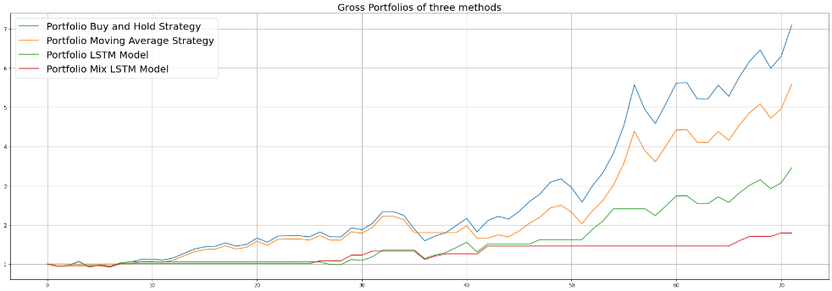
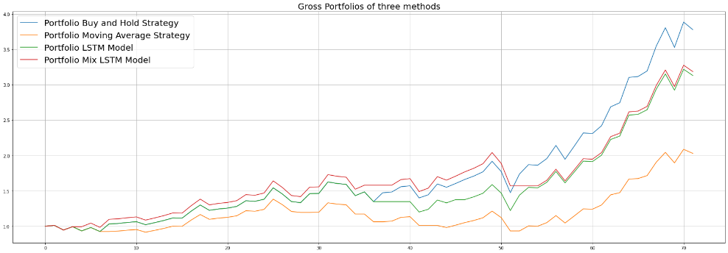
Prediction Plots:
(American Stocks, NASDAQ)
Apple Inc. (AAPL)
Alphabet Inc. (GOOGL)
Notes:
And these plots represent the predicted growth of Apple Inc. and stocks of Google.

Slide 23
Buy Hold Strategy appears to predict maximum net yield in almost all cases considered in this study, but this method is prone to market fluctuations, and this method relies on faith that the price will eventually rise in the long term. This assumption/faith can be risky for investors relying blindly on this strategy.
The two Deep Learning strategies, LSTM and the Novel Hybrid CNN-LSTM predict similar results.
However, the Hybrid Architecture introduced in this study is computationally inexpensive and takes much less training and prediction time than the existing LSTM Architecture for time series prediction.
Findings of this study have an increased accuracy of predictions with reduced/incomparable risks compared to the two manual statistical methods tested.
Notes:
This study concludes that we can improve the efficiency of the Vanilla LSTM Network by using ensembled LSTM-CNN networks without much increase in the training and response time.
In this study, we successfully compared black-box deep learning models to statistical models and proved their accuracy in predicting yield from the financial market.
Through this study, we provide to the community stockDL, which is a Python Library for predicting annual yields by investing in a particular stock.
I hope you all liked the study and know more about the project.

Slide 24
Bao, W., & Liu, X. (2019). Multi-Agent Deep Reinforcement Learning for Liquidation Strategy Analysis. https://arxiv.org/abs/1906.11046v1
Lu, W., Li, J., Li, Y., Sun, A., & Wang, J. (2020). A CNN-LSTM-based model to forecast stock prices. Complexity, 2020. https://doi.org/10.1155/2020/6622927
Li, Z., Liu, X.-Y., Zheng, J., Wang, Z., Walid, A., & Guo, J. (n.d.). FinRL-Podracer: High Performance and Scalable Deep Reinforcement Learning for Quantitative Finance.
Chollet, F. (2018). Deep Learning with Python. In Manning.
Fischer, T., & Krauss, C. (2018). Deep learning with long short-term memory networks for financial market predictions. European Journal of Operational Research, 270(2), 654–669. https://doi.org/10.1016/J.EJOR.2017.11.054
Notes:
The following studies were used to formulate and strengthen the proposed solution.

Slide 25
Demo Available At: https://bit.ly/stockDL_MISP135
Notes:
I would like to Thank everyone for being attentive.
Over to the audience for any questions.
A link to demo of the library is shown on the screen and is added in chat for everyone.

